Slide 1
Warehouse Binner

Slide 2
Day 1
Introduction

Slide 3
What is a Warehouse?
Commercial building for storage of goods.
Used by manufacturers, importers, exporters, wholesalers, transport businesses, customs, etc.
Usually have loading docks to load and unload goods from trucks.
Have cranes and forklifts for moving goods
Stored goods can include any raw materials, packing materials, spare parts, components, or finished goods associated with agriculture, manufacturing and production.

Slide 4
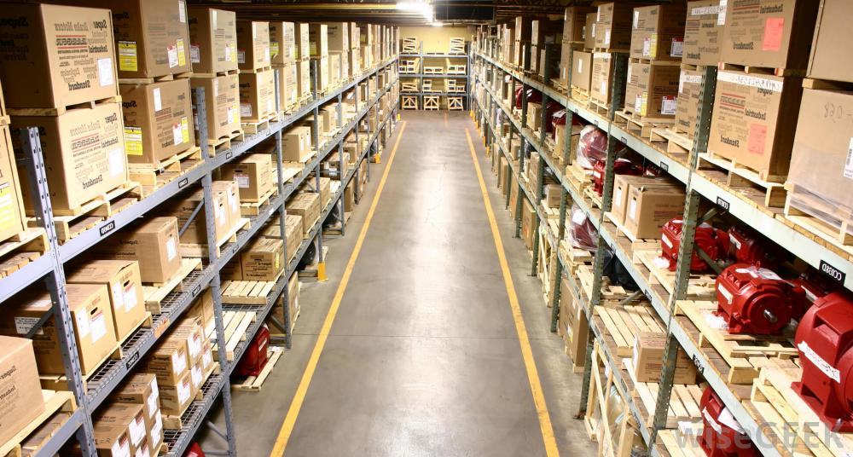
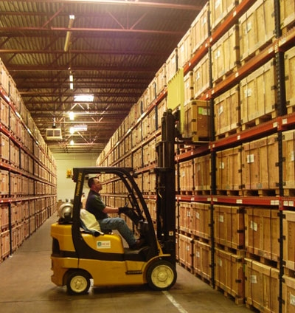
How does a warehouse look like?

Slide 5
Warehouse Management System (WMS)
Key part of the supply chain and primarily aims to control the movement and storage of materials within a warehouse and process the associated transactions, including shipping, receiving, put away and picking.
Monitors the progress of products through the warehouse. It involves the physical warehouse infrastructure, tracking systems, and communication between product stations.

Slide 6
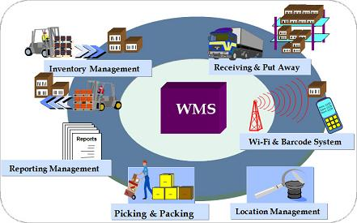
How does a WMS look like?

Slide 7
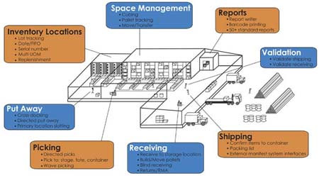
Inside view of a WMS

Slide 8
Flow of inventory in a warehouse
It can be divided into three basic processes:
Receiving items at the warehouse and making them available.
Handling items for internal distribution/movement/production.
Picking and shipping items to customers or other locations.

Slide 9
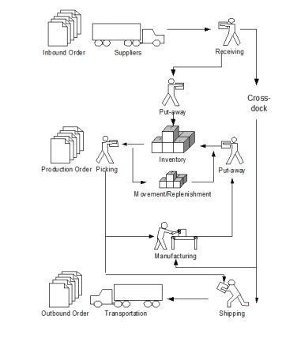

Slide 10
Following video will give you an overview of WMS
https://www.youtube.com/watch?v=XkoHH806S9w

